Slide 1



PyTorch
Bootcamp
Fundamentals of Artificial Intelligence,
Machine and Deep Learning
A. A. 2025/26
Slide credits: Chiara Plizzari
Teaching Assistants: Davide Sferrazza, Stephany Ortuño Chanelo

Slide 2
How to setup a project from scratch
Lesson 3

Slide 3
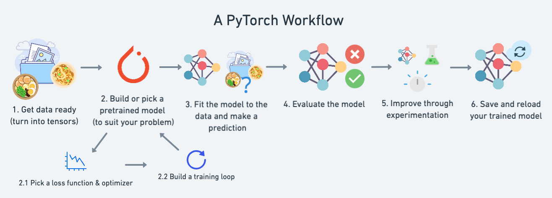
PyTorch Workflow
How to keep track of your changes/results?

Slide 4

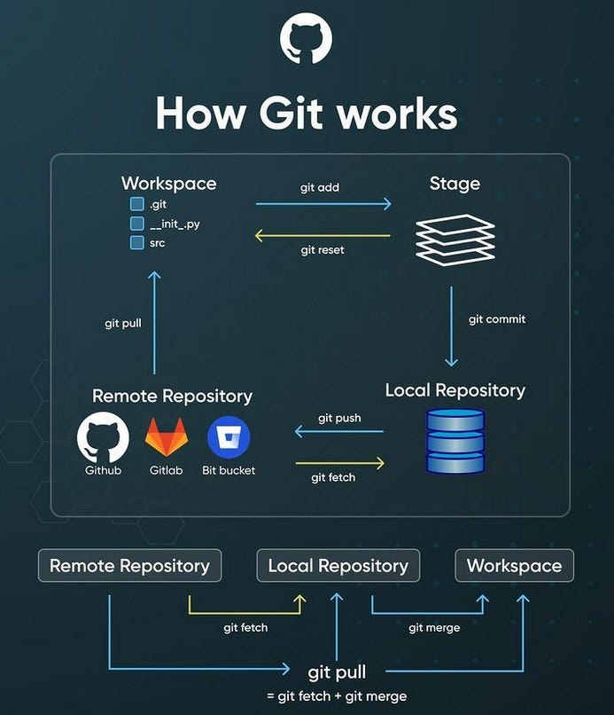
Github
Cloud-based platform
Born for collaboration and version control
Repositories are cloud-saved folders saving remotely all your files
https://education.github.com/git-cheat-sheet-education.pdf

Slide 5
Github
Main commands:
Clone: copies a repository to your machine (execute the first time)
Status: tells us about the status of our repo
Add: adds the local changes to the “to send remotely” files
Commit: prepares “the package” of changes to send (and let you add a message, representing what you did)
Push: Really pushes everything to your remote repo
Pull: sync your local changes with the changes happened in the remote repo (useful to bring in your local folder the changes a team member pushed)
https://docs.github.com/en/get-started

Slide 6
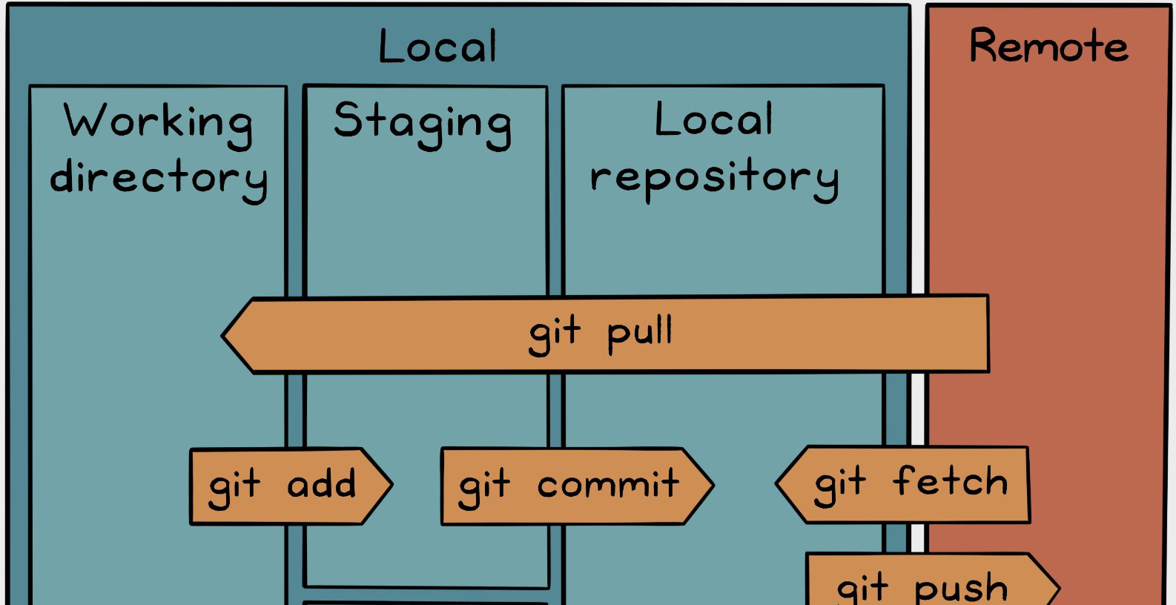
Github
Typical Workflow
git clone <repo>
For every change you make:
… local changes …
git add .
git commit -m ‘Explain message’
git push
Pushing small, incremental changes is almost universally considered better than pushing large, sweeping changes

Slide 7
How to keep track of your results?

Slide 8
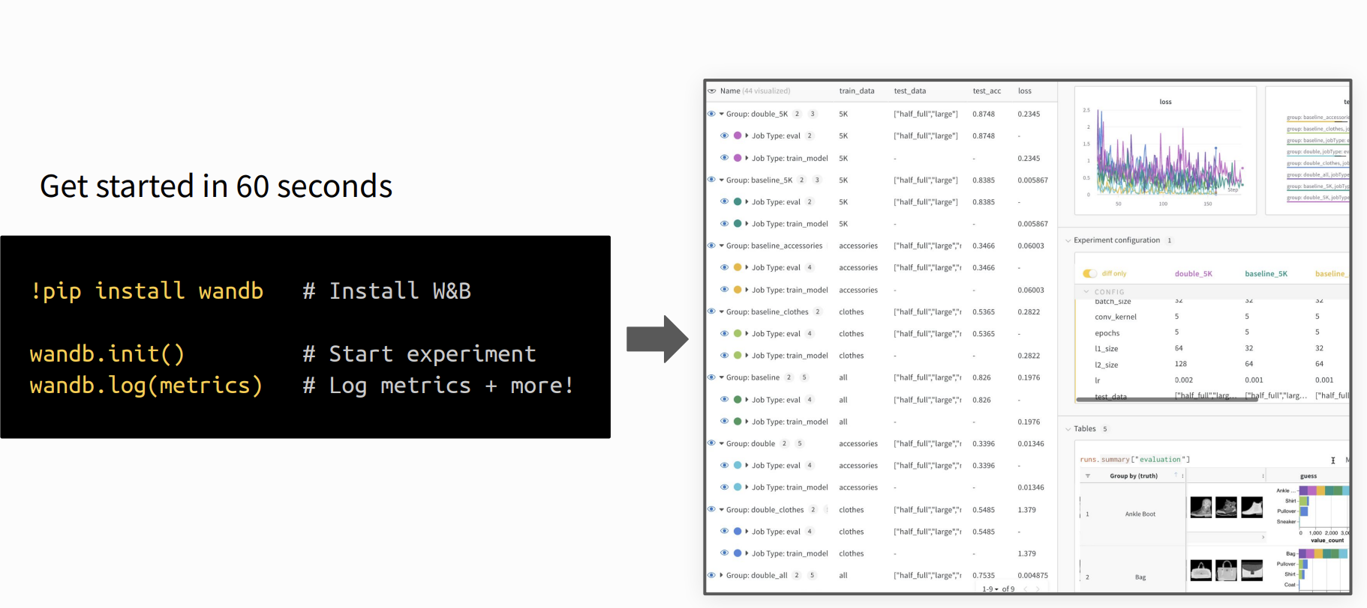

Wandb: record all your results
Wandb is a ML development platform that allows users to track and visualize various aspects of their model training process in real-time

Slide 9
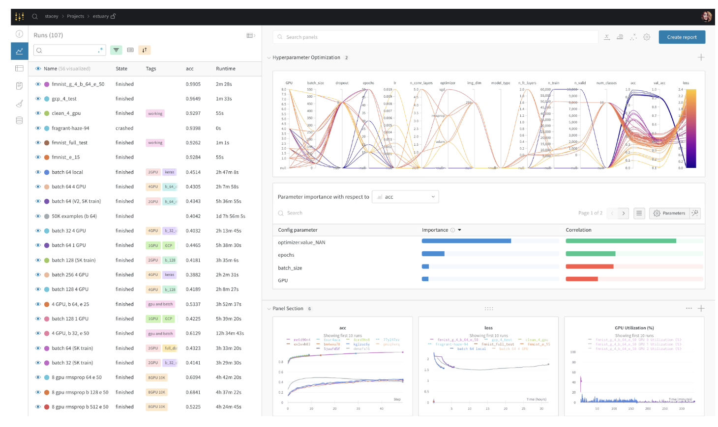
Never lose your progress
Save everything you need to debug, compare and reproduce your models — architecture, hyperparameters, weights, model predictions, GPU usage, git commits, and even datasets — with a few lines of code.

Slide 10
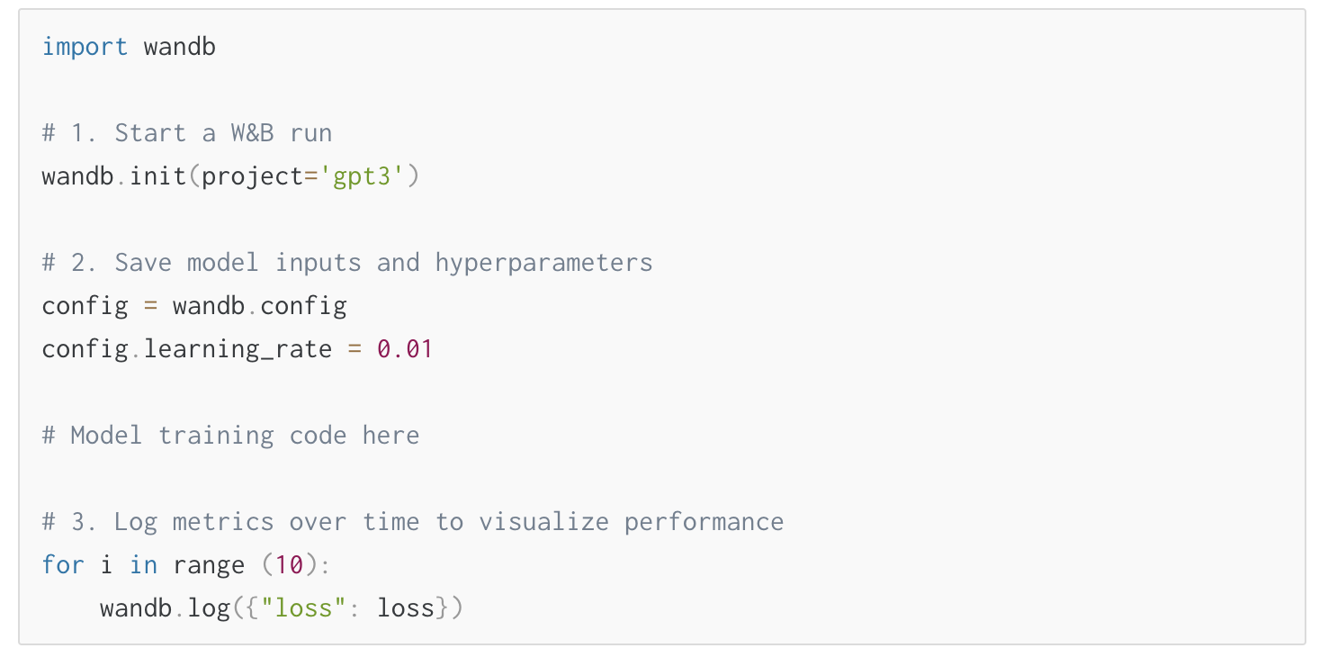
Track your model training

Slide 11
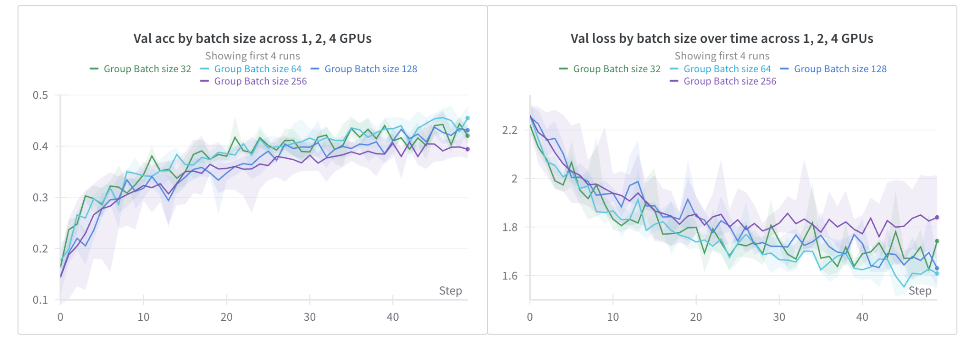
Track your model training

Slide 12
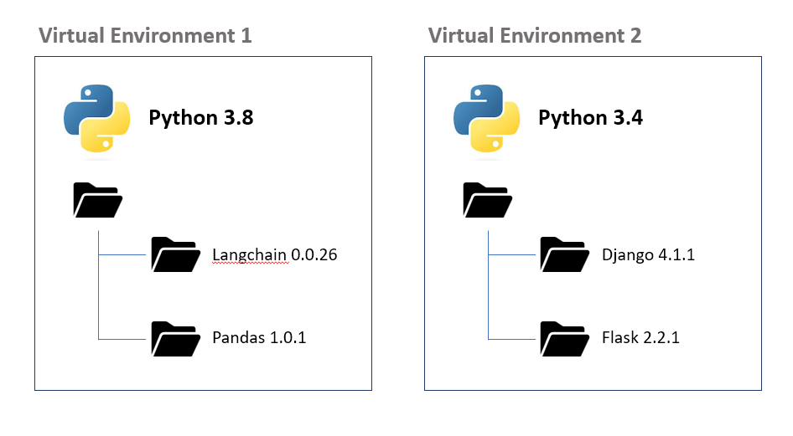

Virtual Envs and Pip Package Manager
A virtual environment is a tool that helps to keep dependencies required by different projects separate by creating isolated Python environments for each project.
System’s Python
https://packaging.python.org/en/latest/guides/installing-using-pip-and-virtual-environments/

Slide 13


Colab special commands
! <command>: executes a bash command (e.g ls, cp, mv, git..) in a new, temporary subshell
% <command>: executes a special command (e.g. cd) for the current session

Slide 14
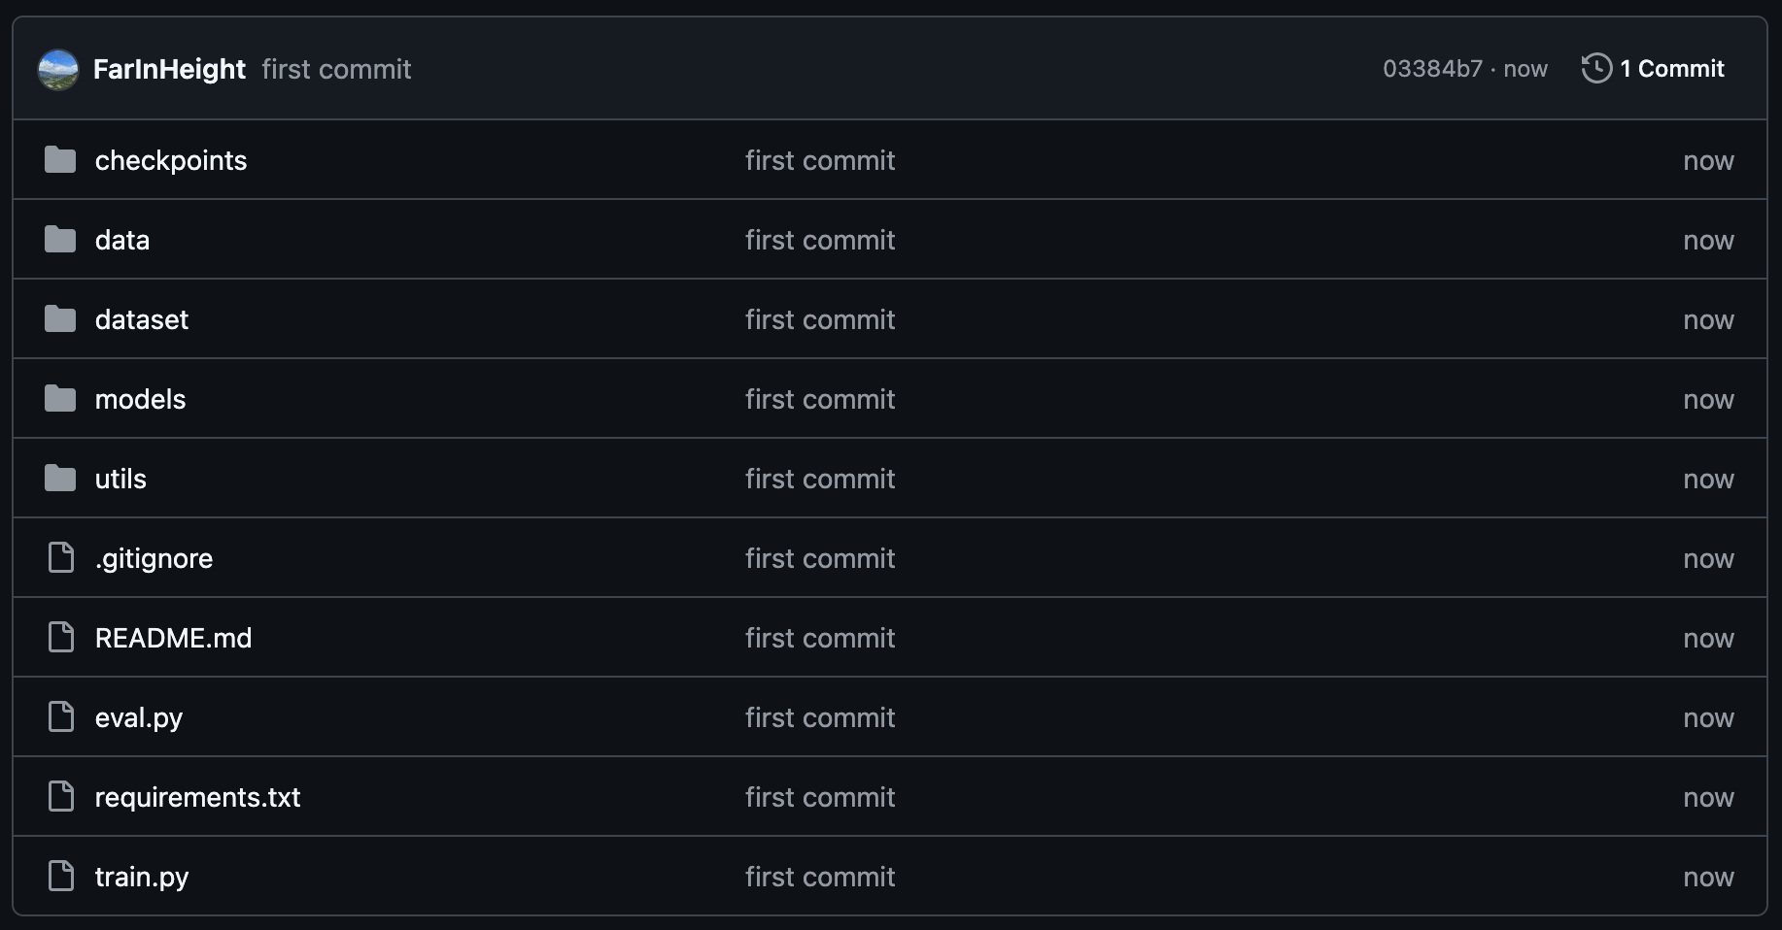
Goal of this lab:
Use Github, Wandb and Pip to setup a structured project.
Here you will save your saved models
Here you will save
your dataloader/dataset
classes
Here you will save
your actual dataset(s)
Here you will save
your architectures (PyTorch)
Here you will save
utils that support your code (e.g., scripts/visualization etc)
Eval logic
File containing the pip packages you installed (for reproducibility)
https://github.com/FarInHeight/lab-project-skeleton
Training logic

Slide 15
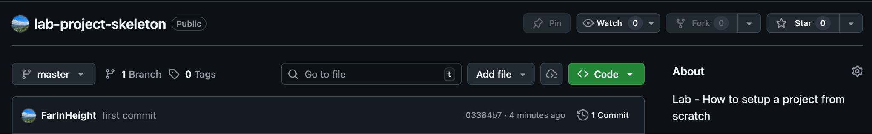
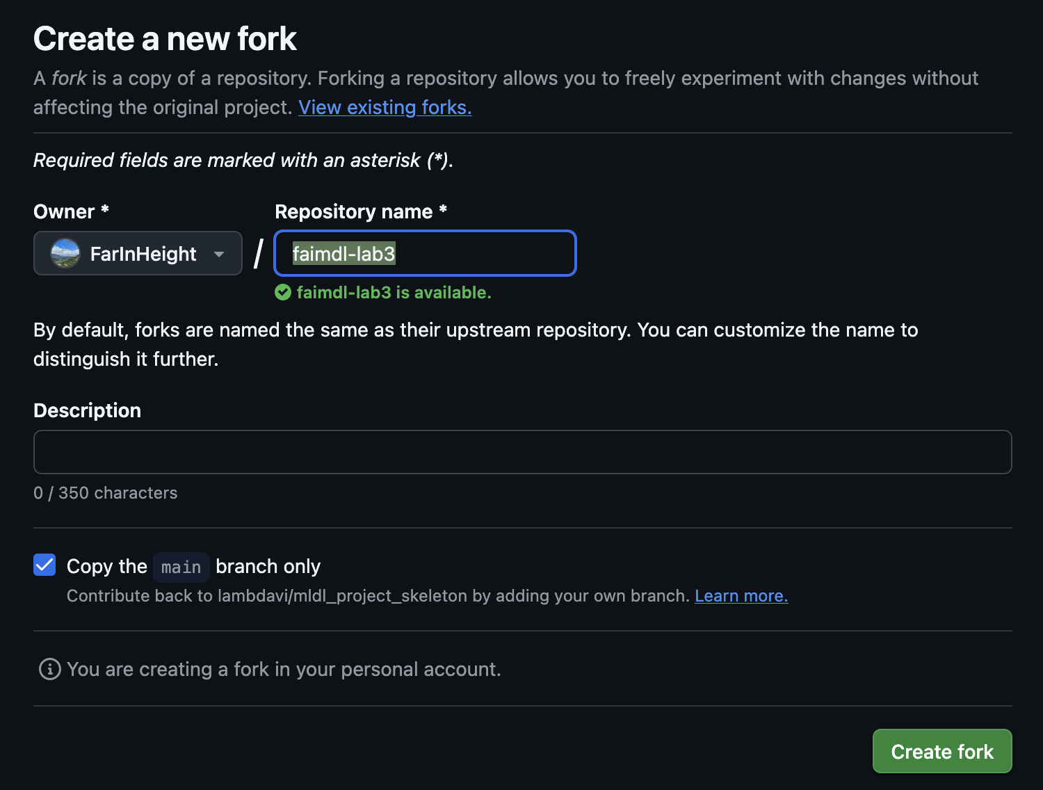
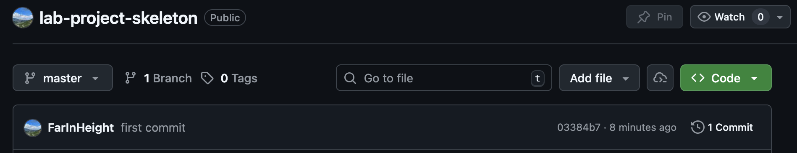
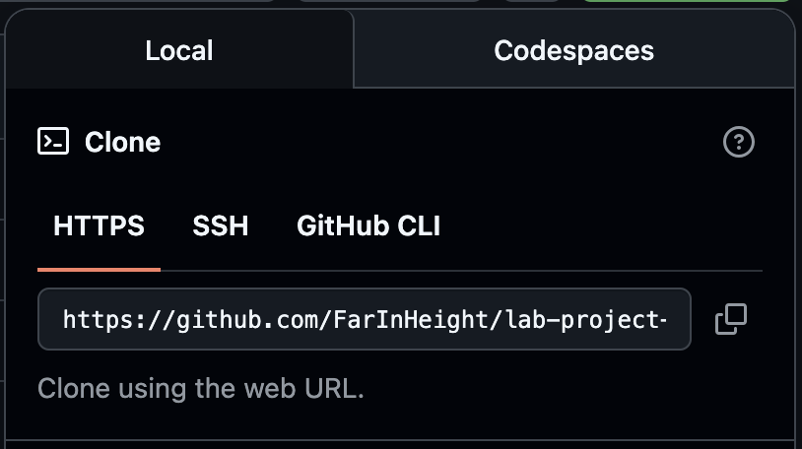
Github
Step 1: Fork the project
Step 2: Name your repository (e.g., faimdl-lab3)
Step 3: Copy the link to the repo

Slide 16
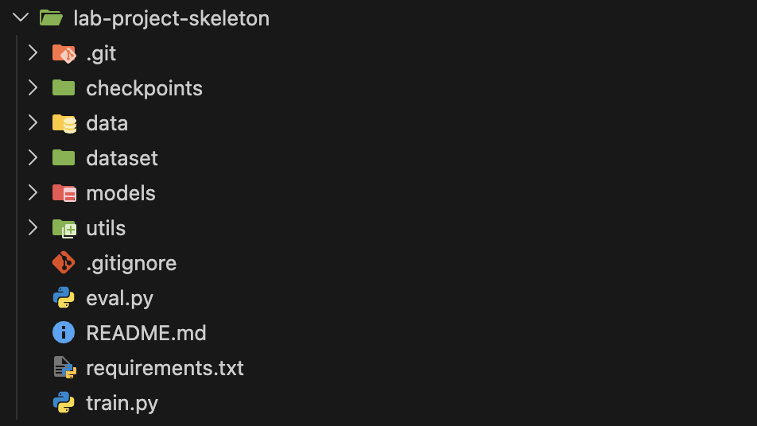
Step 4: Use CMD/Terminal to clone the repository you forked (you may have to install git if it says “command not found”)
Step 5: Open the folder on your favourite code editor (e.g., VSCode)

Slide 17
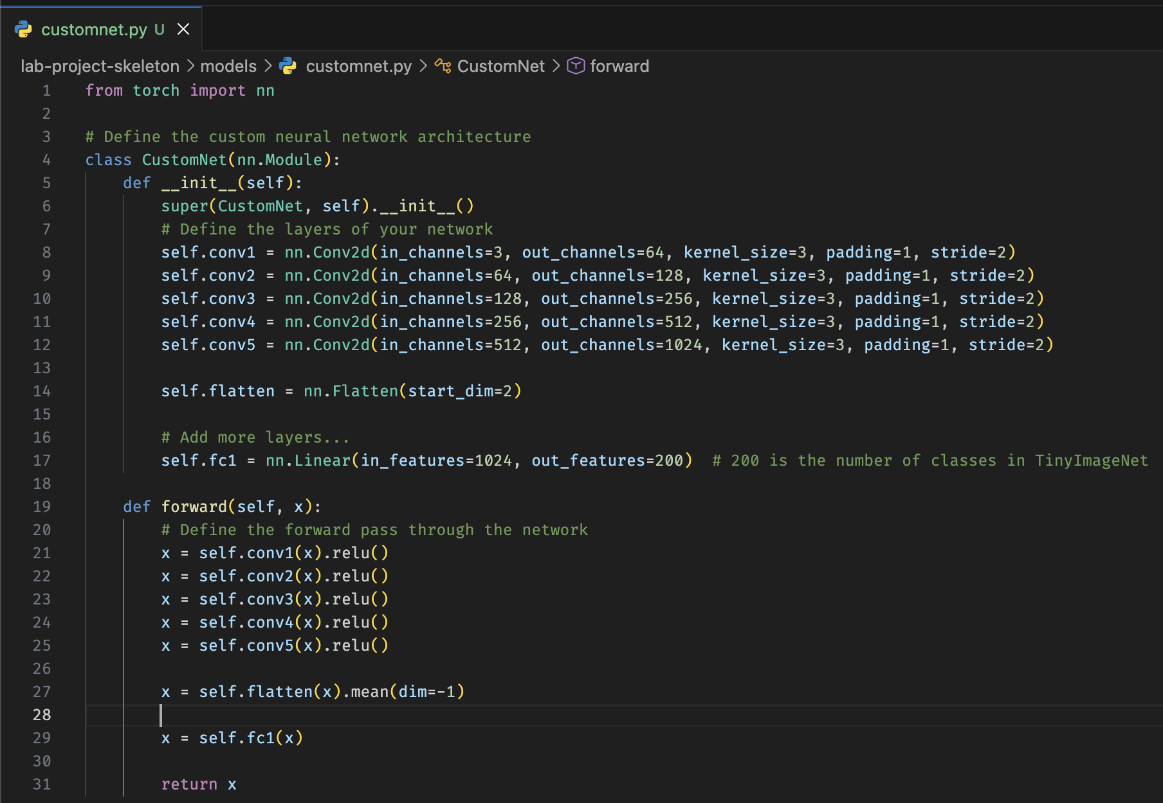
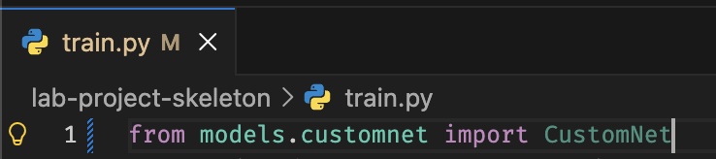
Step 6: Make the changes to the files, add new files etc

Slide 18
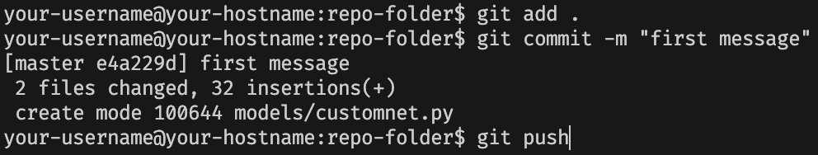
Step 7: Use add, commit and push to put your files back on github
NOTE: Do not push any dataset on Github!!!

Slide 19
Once you finished to setup your project locally and pushed everything on Github you should be able to see your new files in the repository!
Now you can open Colab, clone your repo, download the datasets (on colab) and run your code.

Slide 20

Your turn!
It’s time to setup your project!
At this link https://github.com/FarInHeight/lab-project-skeleton you can find the starting repo (TO FORK).
Fork our repo and then clone your repo on your computer.
Take your code from Lab1/Lab2 and populate the repo with Python files in the right directories.
Add visualization logic.
Test your code on Colab.
Notebook @ https://colab.research.google.com/drive/1sLHv8x3p_SOI2Y6wo5sf1XaId329HxH4?usp=sharing

